Slide 1

SITE SEEING NAVIGATION MUSEUM APP
Supervised by: DR Yasser Abdelhamid

Slide 2
TEAM MEMBERS:
Rodina Adel
Mariam Hamza
Adham Ashraf
Mohamed Ali
20-00394
20-00614
20-01126
RAMEZ AMGAD
CHERIF ADEL
ABDALLAH HESHAM
20-01233
20-01248
20-00794
20-00309

Slide 3
AGENDA
INTRODUCTION
Similar work
Analysis
Motivation
Proposed solution
Our app technologies
Aim & Objectives
Prototype
challanges
Future work
Previous work

Slide 4
01
INTRODUCTION

Slide 5

Introduction
Provides a cutting-edge navigation tool within the museum premises.
Addresses challenges faced by tourists
Ensures visitors from different backgrounds can easily access information
increases visitor engagement and satisfaction through intuitive navigation and information access.

Slide 6
02
Motivation

Slide 7

Motivation
1-Navigation Difficulties: Visitors often encounter challenges finding their way through the extensive halls and exhibits of the museum
2-Language Barriers: International visitors often face difficulties due to a lack of multilingual support
3-Inadequate Information Delivery: Providing detailed information about exhibits in an engaging manner is challenging with traditional methods

Slide 8
03
Problem Solution

Slide 9


Proposed Solution
Our project addresses the need for an intuitive indoor mapping app to enhance visitor navigation and engagement, a chatbot for providing informations , and multilingual support

Slide 10
04
AIM AND OBJECTIVES

Slide 11

Aim & Objectives
The project seeks to solve the challenge of inefficient navigation within the Antiquities Museum

Slide 12
Aim & Objectives
1. Develop an interactive and visually appealing map of the museum.
2. Implement location services to accurately track and guide users within the museum.
3. Ensure compatibility with both iOS and Android platforms.
4. Integrate features for exhibit information, restroom locations, and other amenities.
5. Enhance user engagement through additional educational content and multimedia features.

Slide 13
05
CHALLENGES

Slide 14

Challenges
Develop an application capable to
give high quality of services to user
facilities the user experience by finding the shortest path in less time
Make it easer to user to reach their desired destination into the museum.

Slide 15
06
Previous work

Slide 16

Previous Work
The system needs to use the GPS program in drawing maps, but there were some difficulties such as:
software license,
GPS usage was difficult as it covers small map scale and gives no exact coordination.
To overcome these challenges, the system is designed to give instructions to the user by using APIs to get the current location of the user.

Slide 17
07
Similar Work

Slide 18
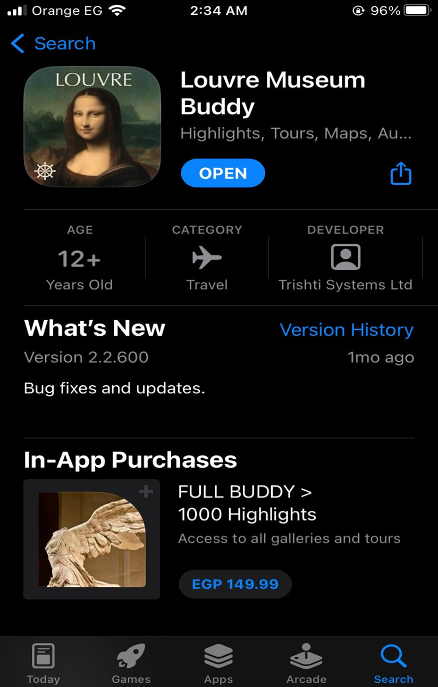
Similar Work
louvre museum buddy
explore galleries of louvre with guided tours , and maps
Inside the app:
Map
Room navigation

Slide 19
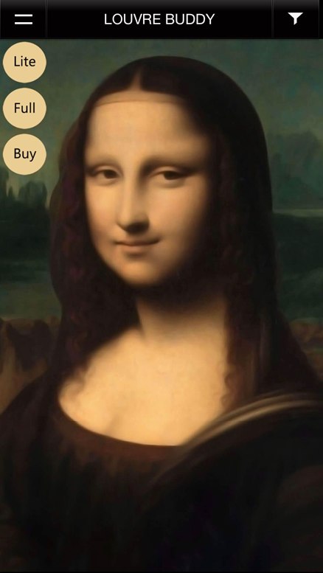
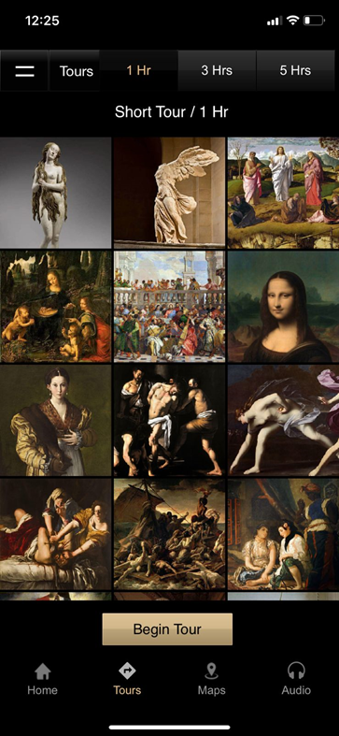
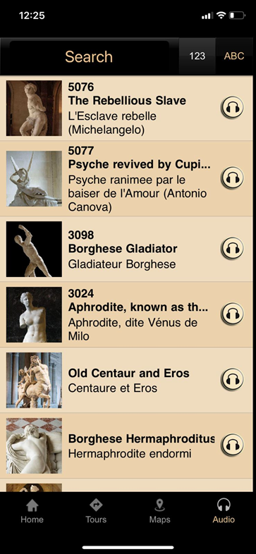
Similar Work
louvre museum buddy
Disadvantages:
Limited Functionality
Mobile Responsiveness
Cluttered Layout
Navigation Issues
Unpleasant color co-ordination

Slide 20
08
Analysis

Slide 21


Analysis
Planning
Designing The UI/UX Of The Project And Learning The Technology We Agreed To Use, Which Is Flutter Framework
Intake
Excute
Implementing The Project On Android Studio IDE With The Ideas We Had in Mind And Ideas We Found Online.
Understanding The Project Idea And Determining Its Priorities And Objectives And How To Make It Better And Easier At The Same Time For The User.
Initiations
Define The Project Directions And Team Accountability Of Doing It And Deciding What Technology To Use To Implement It.
Close
Having A Final Meeting With Dr. Yasser To Know The Needed Edits And Improvements He Thinks We Should Add. Execute The Work As Per Plan While Focusing On Managing Quality And Needs. Adding The Final Touches in The Project Code

Slide 22
09
Our App Technologies

Slide 23
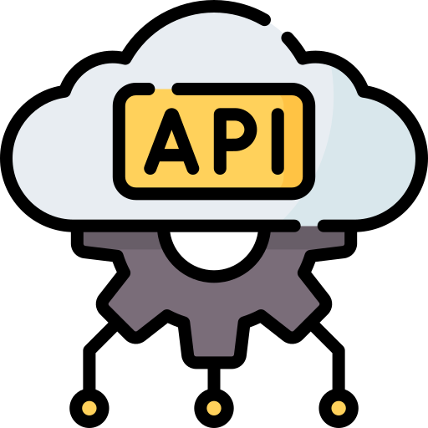
Our App Technologies
“API” means Application Programming Interface.
Why we Use API?
To store and retrieve data (like antique collections) in real-time.
To provide backend services without the need for your own server infrastructure.

Slide 24
Our App Technologies
To update the user's position on the museum map in real-time.
To get the current GPS coordinates of the user's device.
To request and check permissions for accessing the device’s location, which is necessary for the Geolocator API to function correctly

Slide 25

Our App Technologies
Why Flutter?
Cross-Platform Development: Single codebase for both Android and iOS
Rich UI Capabilities: Extensive widget library for creating expressive and flexible UIs
Firebase Integration: Seamless integration with Firebase for backend

Slide 26
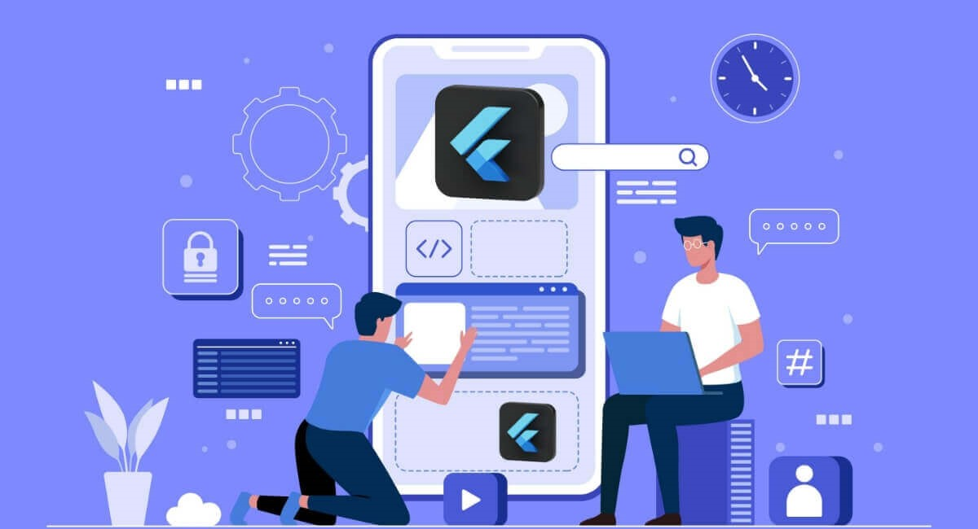
Our App Technologies
Fast Development: Hot reload feature for real-time code changes, speeding up development and debugging.

Slide 27

Our App Technologies
A powerful programming language developed by google
It's particularly popular for building web and mobile applications
Dart is designed to be easy to learn and use, while also being highly efficient for large-scale projects

Slide 28

Our App Technologies
What is Firebase?
A flexible, scalable database for mobile, web, and server development.
Cloud storage solution for storing and serving user-generated content like images, videos, and other media files
Provides real-time synchronization of data across all clients. This ensures that any changes in the database are immediately reflected in the app.

Slide 29
Our App Technologies
How We Use Firebase in Our Project:
To store and retrieve data for various collections like antiques
To store and serve user-generated content such as images of the antiques and it’s description in database

Slide 30
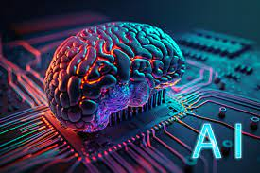
Our App Technologies
AI Chatbots:
AI chatbots are software applications that simulate human
conversation using natural language processing (NLP) and
machine learning. They are designed to engage users,
provide information, and assist with tasks.

Slide 31

Our App Technologies
What is Voiceflow:
is a collaborative design and prototyping tool for creating voice and conversational applications
-Rapid Prototyping and Iteration
How We Use Voiceflow in Our Project:
1-Add HTTP Package.
2-Create a Service for Voiceflow API Interaction.

Slide 32
10
Prototype

Slide 33
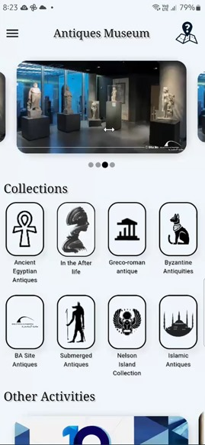
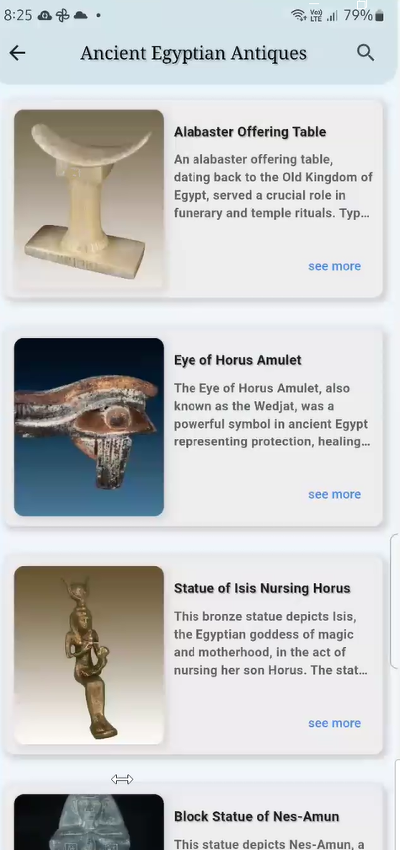
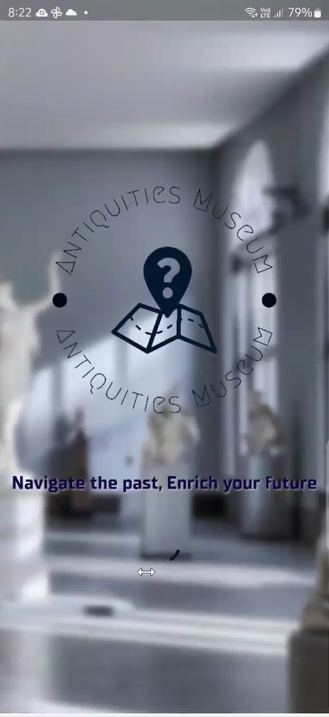
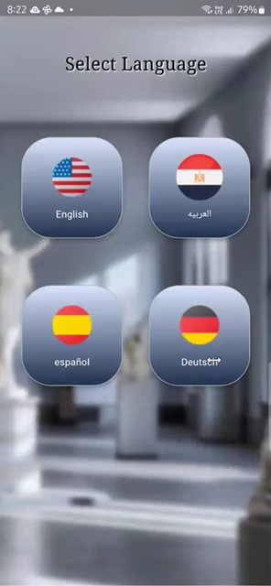
Prototype

Slide 34
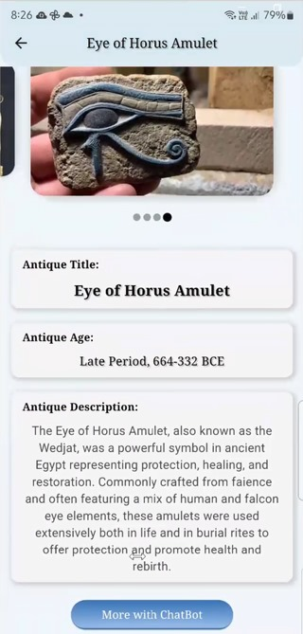
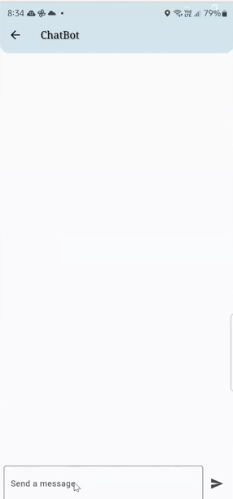
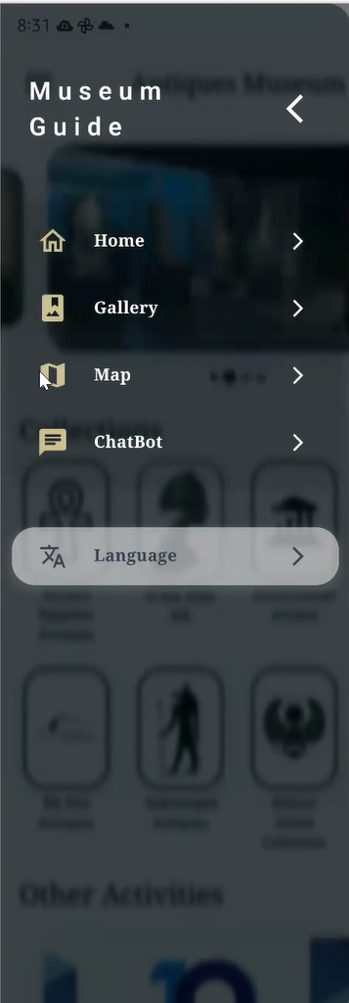
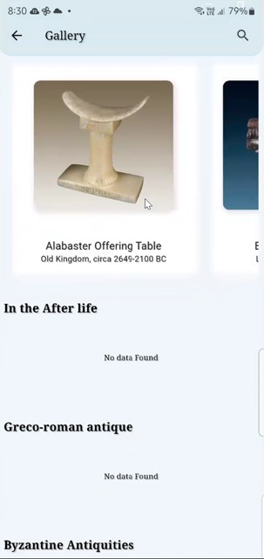
Prototype

Slide 35
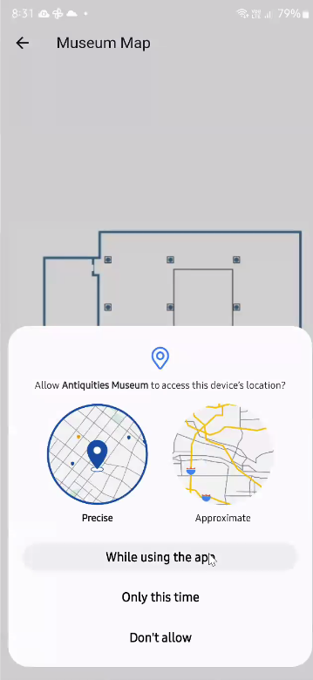
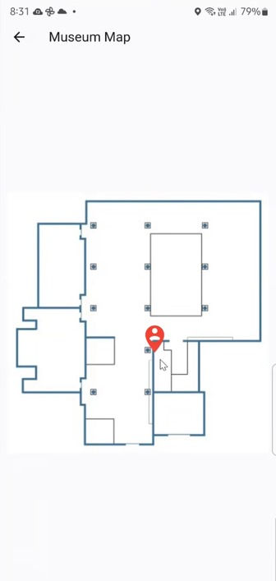
Prototype

Slide 36
11
Future Work

Slide 37
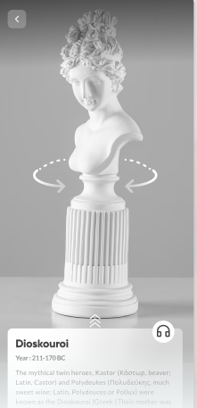
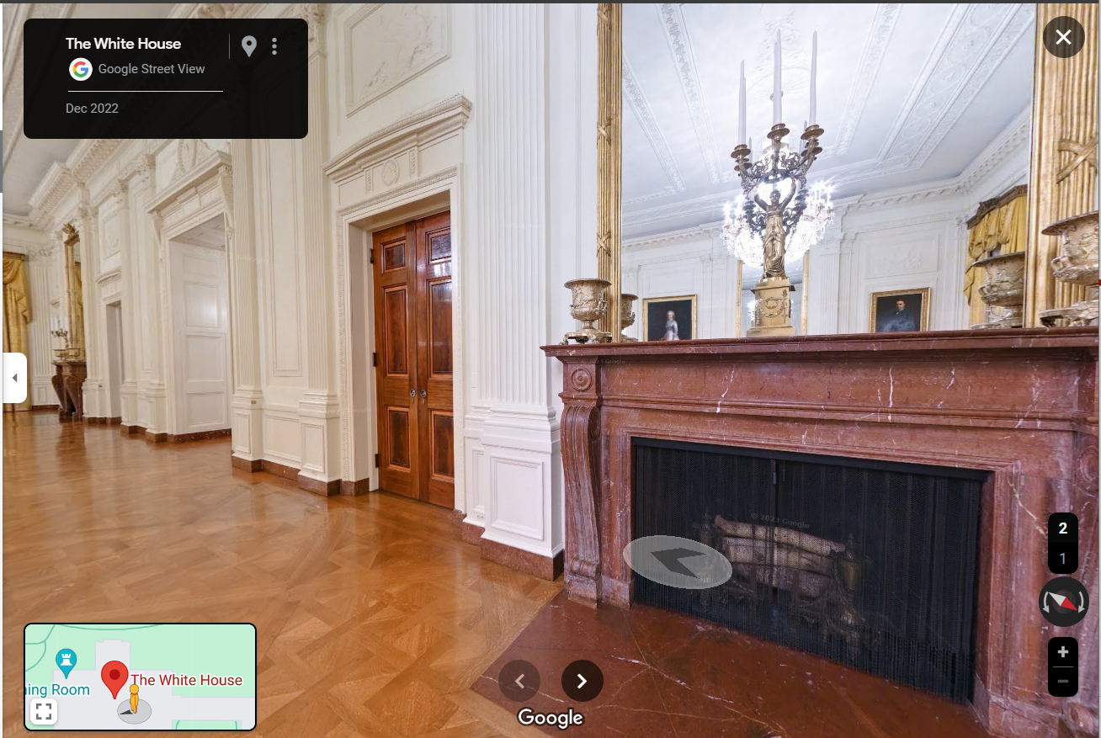
Future work
Augmented Reality (AR) Experiences:

Slide 38
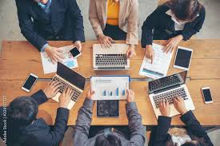
Future work
Long-Term Sustainability:

Slide 39
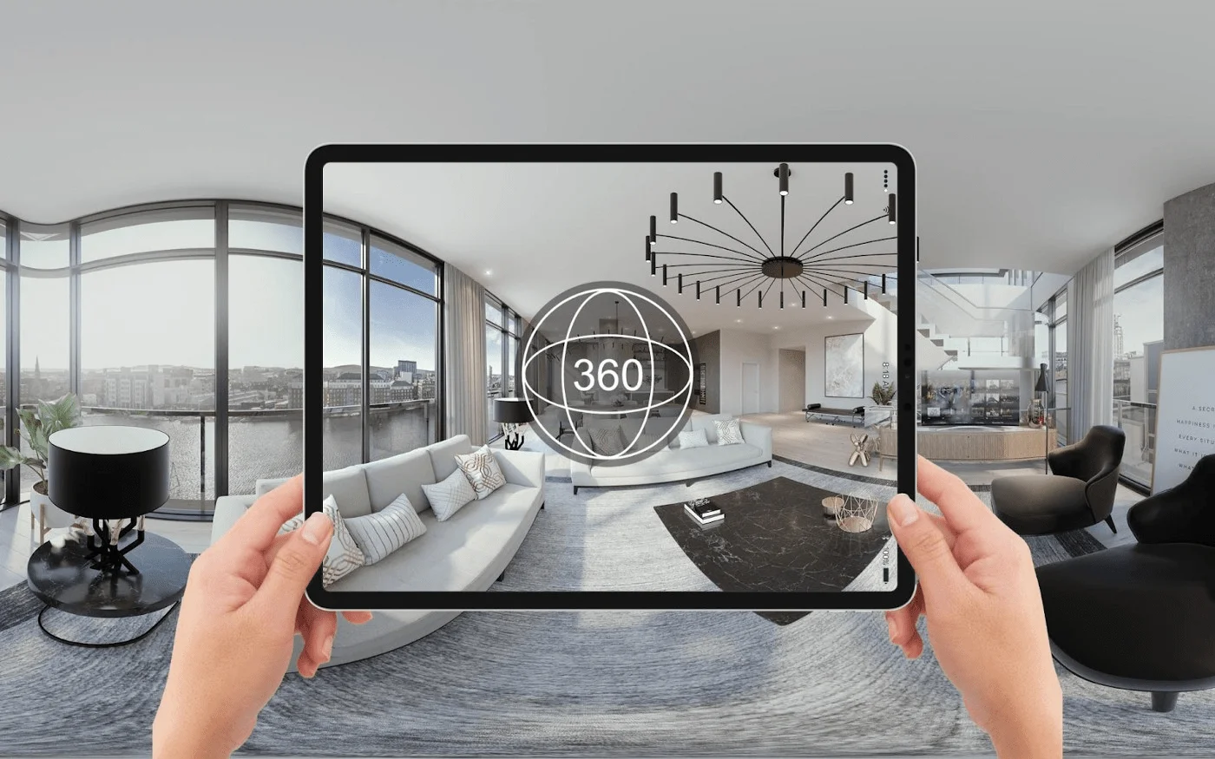
Future work
3D Models and Virtual Tours:

Slide 40
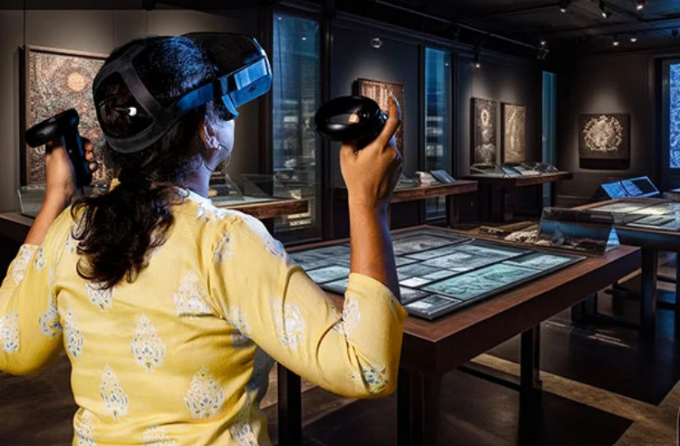
Future work
Virtual Reality (VR) Integration:

Slide 41
Thank you!
Dr. Yasser Abdelhamid Dr. Kamal Safwat Dr. Rodina Abdelsalam

